Slide 1
第五课：我的中国旅行
©沈蕾BYU-Idaho 2019

Slide 2
我们举行庆祝 4
我们举行庆祝， 救恩之日到来。 不做异乡客， 不在地上徘徊。 大好信息正向我们各国传播。 救之良辰，为期已不甚远。 一切蒙主应许， 众圣徒受恩赐， 清晨到黄昏。 无人再受苦难。 伊甸园行将在,地面上出现， 耶稣招以色列万民同回家园。 | Wǒmen jǔxíng qìngzhù, jiù ēn zhī rì dàolái. Bù zuò yìxiāng kè, bùzài dìshàng páihuái. Dàhǎo xìnxī zhèng xiàng wǒmen gèguó chuánbò. Jiù zhī liángchén, wéiqí yǐ bù shèn yuǎn. Yīqiè méng zhǔ yīngxǔ, zhòng shèng tú shòu ēncì, qīngchén dào huánghūn. Wú rén zài shòu kǔnàn. Yīdiànyuán xíng jiàng zài dìmiàn shàng chūxiàn, yēsū zhāo yǐsèliè wànmín: Tóng huí jiāyuán.

Slide 3
感谢神赐给我们先知 10
神啊，感谢您赐给我们先知， 领导我们度此末世。 感谢您给我们的福音， 照耀我们心地光明。 感谢您这一切的祝福， 出自您仁慈的赐予。 我们乐意都来侍奉您， 遵守您所有的诫命。 | Shén a, gǎnxiè nín cì gěi women xiānzhī, lǐngdǎo wǒmen dù cǐ mòshì. Gǎnxiè nín gěi wǒmen de fúyīn, zhàoyào wǒmen xīndì guāngmíng. Gǎnxiè nín zhè yīqiè de zhùfú, chūzì nín réncí de cìyǔ. Wǒmen lèyì dōu lái shìfèng nín, zūnshǒu nín suǒyǒu de jiè mìng.

Slide 4
Song 156 Called to Serve méng zhāo huàn fú wù 蒙召换去服务 Verse 1
Méng shén zhāohuàn róngyào tiānshàng de fù， xuǎnzé yǒngyuǎn wèi tā
蒙 神 召 唤 荣 耀 天 上 的 父， 选 择 永 远 为 他
zuò jiànzhèng. wǒmen qiánwǎng gèchù xuànyáng fúyīn， gāoshēng
作 见 证 。 我 们 前 往 各 处 宣 杨 福 音， 高 声
xuānyáng tā àixīn. Qiánjìn, yǒngyuǎn qiánjìn, róngyào guīyú tā de míng,
宣 扬 他 爱 心。前 进 永 远 前 进，荣 耀 归于 他 的 名,
Qiánjìn yǒngyuǎn qiánjìn róngyào guīyú tā de míng, yǒngwǎng yǒngwǎng
前 进 永 远 前 进， 耀 归 于 他 的 名, 勇 往 勇 往
zhíqián wǒmen gāogē qìng kǎixuán， shén zhù wǒ shènglì yǒngyuǎn xiàng 直 前 我 们 高 歌 庆 凯 旋， 神 助 我 胜 利 永 远 向 qiánjìn cǐ xīn yǒng bù yu 前 进 此 心 永 不 渝。

Slide 5
计算恩典 149
有时遇见苦难如同大波浪， 有时忧愁丧胆似乎要绝望。 若把主的恩典从头数一数， 必能叫你快乐立时赞美主。 主的恩典样样都要数, 主的恩典都要记清楚。 主的恩典样样都要数， 必能叫你惊讶立时乐欢呼。 | Yǒushí yùjiàn kǔnàn rútóng dà bōlàng, yǒushí yōuchóu sàngdǎn sìhū yào juéwàng, Ruò bǎ zhǔ de ēndiǎn cóngtóu shǔ yī shǔ, bì néng jiào nǐ kuàilè lìshí zànměi zhǔ Zhǔ de ēndiǎn yàng yàng dōu yào shù zhǔ de ēndiǎn dōu yào jì qīngchǔ Zhǔ de ēndiǎn yàng yàng dōu yào shù bì néng jiào nǐ jīngyà lìshí lè huānhū.

Slide 6
复习： 1. I am a PRC Chinese member living overseas, whom should I contact as I prepare to return to China? 2. As a PRC Chinese member living overseas, when I return to China, can I attend Church on Sunday? 3. As a PRC Chinese member living overseas, will Sunday Church meetings in China be similar to or different from the ward/branch I attend now? 5. Who best answers questions asked by Chinese members living outside China?

Slide 7
复习：主语、谓语、状语、定语 1. I am a PRC Chinese member living overseas, whom should I contact as I prepare to return to China? 2. As a PRC Chinese member living overseas, when I return to China, can I attend Church on Sunday? 3. As a PRC Chinese member living overseas, will Sunday Church meetings in China be similar to or different from the ward/branch I attend now?

Slide 8
教学目标： 学完第五课“我的中国旅行”以后，你应该 一、Make a report 二、Recall your memories and describe your past experiences 三、A Review and application of Lesson 1 through 4 vocabulary, grammar, conversations 四、Able to apply vocabulary and grammar learned from this lesson in 5 Cs (Communication, Culture, Connections, Comparisons and Communities) 五、Able to ask and answer questions about travelling in elaboration

Slide 9
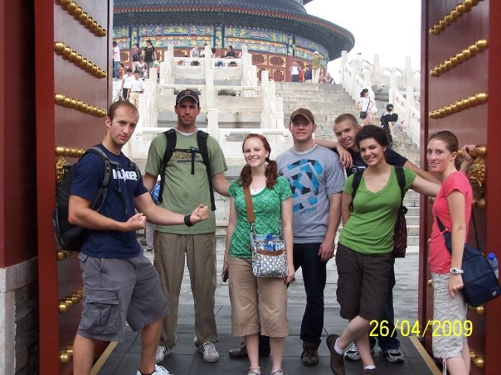
问题一： 你最喜欢去什么地方旅行？为什么？ 浪费 làngfèi v. & n. to waste 时间 shíjiān n. time 钱 qián n. money 了解 liǎojiě v. & n. to understand 文化 wénhuà n. culture 看风景 kàn fēngjǐng v.o. to see scenery

Slide 10
问题二： 你会去奇怪的qíguài de weird 地方旅行吗？为什么？

Slide 11

问题三： 你想来一次想走就走的旅行（trip from the-spur-of-the-moment）吗？ 你最想去哪儿？ (Implication: People are tired of meeting up to other people’s expectations, but want to do something at their own will)

Slide 12
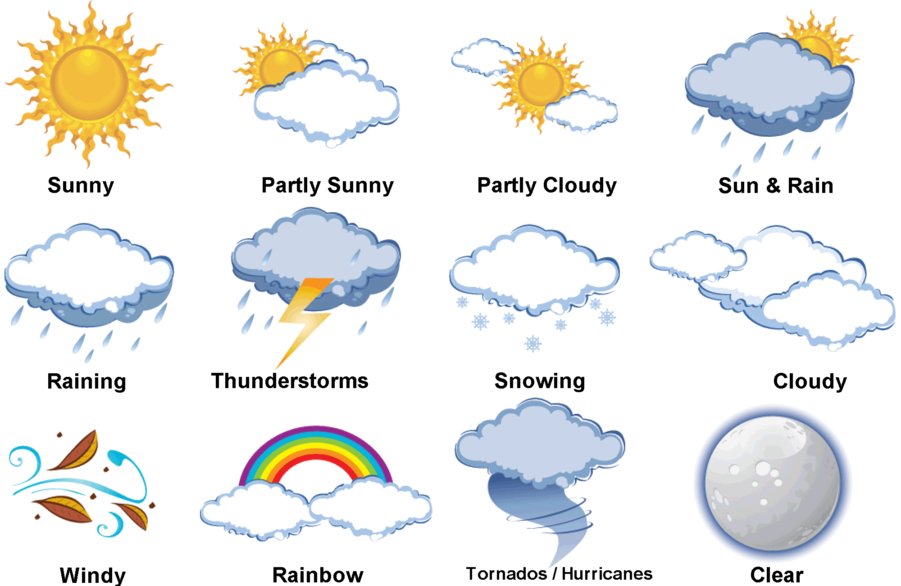
第五课生词 p.136-137 1. 阴 overcast adj. vs. 阴天 n. 多云 adj. duōyún cloudy 晴 sunny adj. vs. 晴天 n. sunny day 下雨 v.o. to rain 毛毛雨 n. drizzles 闪电 v.o. to lightening 打雷 v.o. to thunder 下雪 v. o. to snow 天气 n. weather vs. 气候n. climate 刮风 v. o. guāfēng to blow wind 刮龙风卷 v. o. guā lóngjuǎnfēng to blow tornado 彩虹 n. cǎihóng rainbow

Slide 13
第五课生词 p.136-137 1. 阴 overcast adj. vs. 阴天 n. 多云 adj. duōyún cloudy 晴 sunny adj. vs. 晴天 n. sunny day 下雨 v.o. to rain 毛毛雨 n. drizzles 闪电 v.o. to lightening 打雷 v.o. to thunder 下雪 v. o. to snow 天气 n. weather vs. 气候n. climate 刮风 v. o. guāfēng to blow wind 刮龙风卷 v. o. guā lóngjuǎnfēng to blow tornado
问题： 一、你从哪儿来？你老家的天气怎么样？ 老家：hometown
二、你讨厌tǎoyàn dislike, be tired of 或者喜欢什么样的天气？

Slide 14
第五课生词 p.136-137 2. 终于 adv. Finally Pattern: Context， S + 终于 + V + O 例如：我的室友从来不请客，今天他终于请我的客啦！ 中文怎么说： 1. After flying 24 hours, they finally arrived in New York. 2. America has finally stopped flying Boeing 737 Max. 3. Make a sentence of 终于 of your own

Slide 15
第五课生词 p.136-137 3. 本来 adv. Originally Pattern: S + 本来 + V + O, 可是。。。。。。 例如：我的房东本来让我把车开走，可是现在他说没关系。 完成下面的句子： 一、外国人本来看不懂京剧，可是现在。。。。。。。 二、他和他的室友本来分工合作，可是。。。。。。 三、本来我请客，可是。。。。。。

Slide 16


第五课生词 p. 136-137 4. 飞行 n. & v. 例如：这个飞行员飞行了800个小时。 飞行员 fēixíngyuán pilot vs. 乘客 chéngkè passengers 空姐 kōngjiě 空少 kōngsha4o flight attendant 5. 转机 n. & v. 例如：你飞北京在哪儿转机？ 6. 误点 n. & v. 例如：本来乘客在盐湖城转机，可是他误点了。 7. 赶上 vt. 例如：这些乘客终于赶上了去上海的班机。 8. 班机 n.例如：这个飞行员飞行了800个小时。
看图编故事kàn tú biān gùshì Look at the picture and make a dialogue

Slide 17
第五课生词 p. 136-137
9. 热情 adj. 例如：热情的朋友/老师/空姐/师母/司机/乐师/演员 10 好客 adj. 例如：好客的朋友 vs. 朋友很好客。 热情好客 adj. 例如：老师和师母还是和以前一样热情好客。 11. 津津有味 adv. S + 【V1（吃/听/看）+ O 】+ V1+ 得 + 津津有味 例如： 一、我们【吃师母的拿手菜】吃得津津有味。
二、 他们【看电影】看得津津有味。 三、他们【听美国摇滚乐yáogǔnyuè rock and roll 】听得津津有味。

Slide 18
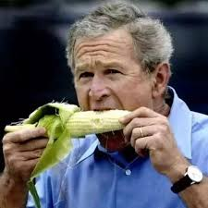


第五课生词 p. 136-137 玉米 yùmǐ corn; 音乐 yīnyuè; 电视 diànshì
中文怎么说： S + 【V1（吃/听/看）+ O 】+ V1+ 得 + 津津有味

Slide 19
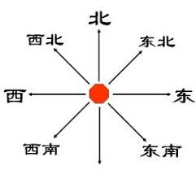
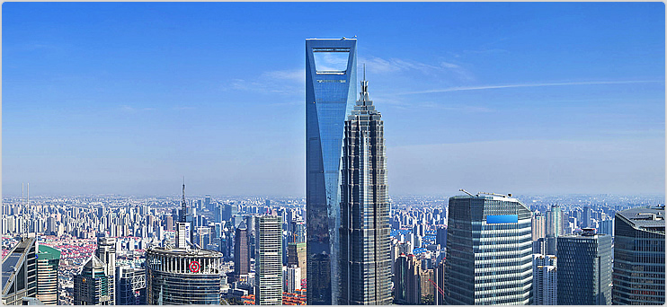
第五课生词 p. 136-137 12. 打开眼界 v.o. eye-opened 例如：旅行可以让人大开眼界。 13. 团 n. group/delegation 旅游团、美食团 14. 方向 n. direction 例如：圣殿在什么方向？ 15. 闹笑话 v.o. to make yourself a laughing stock 16. 繁荣 adj. prosperous 17. 大厦 n. high-rise building 例如：金融大厦 finance high-rise building

Slide 20
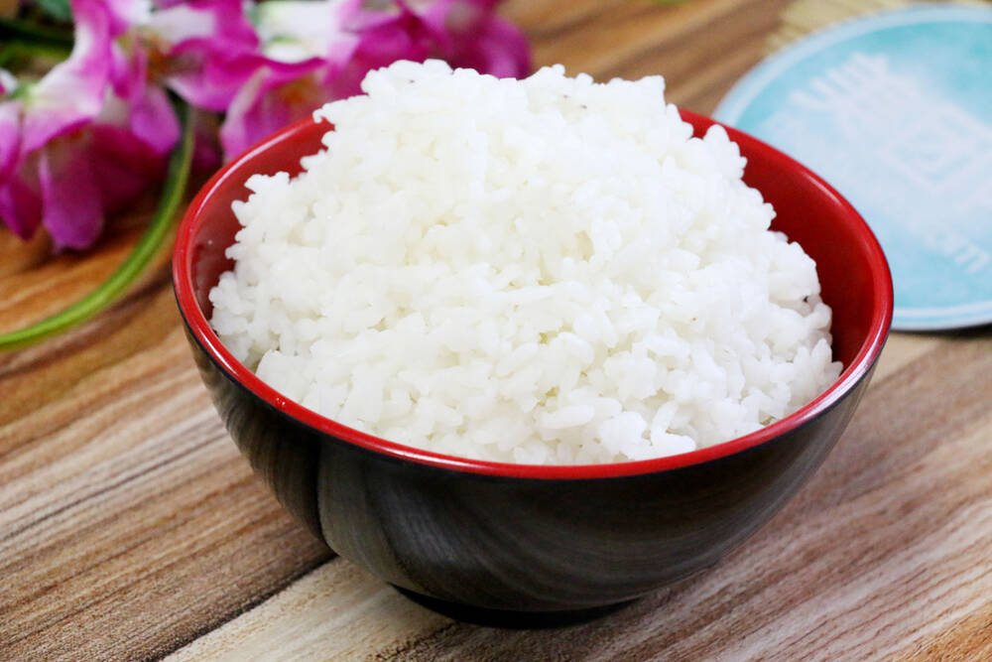

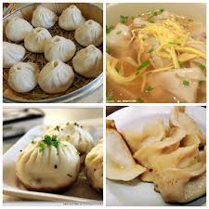
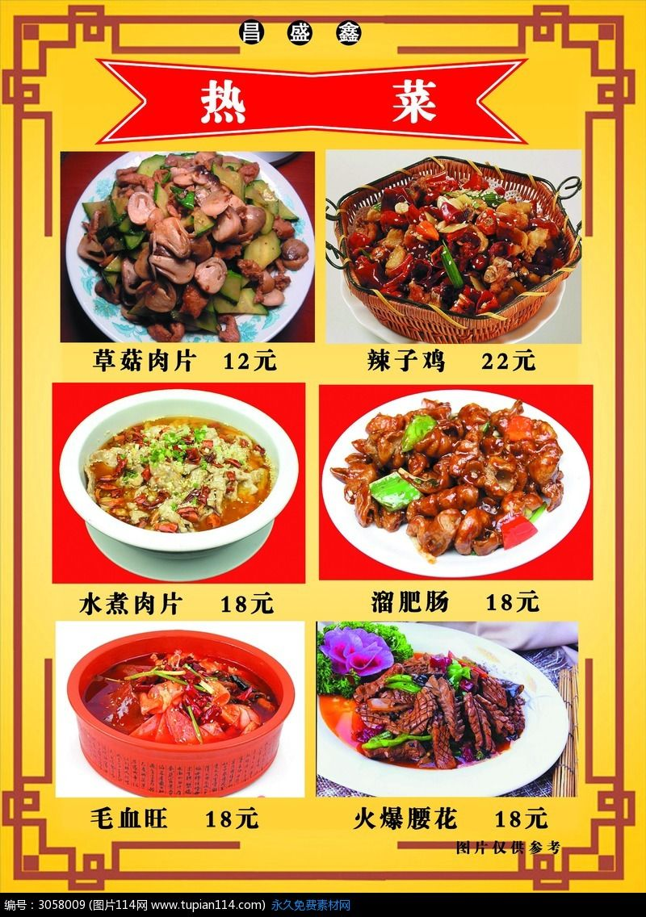
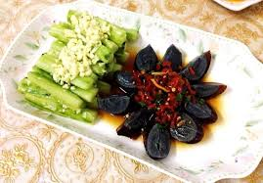
第五课生词 p. 136-137 19. 虽然。。。，但是/可是。。。。 20. 别人 or 其他的人 other people 21. 小吃 vs. 热菜 vs. 凉菜 vs. 饭 vs. 甜点

Slide 21
第五课复习 p.142-145
S + Verb + RC (错、完、好、见、到、上) + O (Usually past tense) 中文怎么说：(use the sentence structure above) 1. If she expects me to get her a job, she is barking up the wrong tree. 2. Teacher’s wife finished cooking her best dishes. 3. We will organize our rooms after we finish moving. 4. Originally we planned to watch Peking opera, but we were not able to see it. 5. The teacher looked for his cell phone for 20 minutes, but he finally found it. 6. Please shut down the computer on your desk before you go on a trip.

Slide 22
第五课复习 p.142-145
1. Resultative Complement S + Verb + RC (错、完、好、见、到、上) + O (Usually past or perfect) 例如：他们 做 错 了 班机。 中文怎么说：(use the sentence structure above) 1. If she expects me to get her a job, she is barking up the wrong tree. 2. Teacher’s wife finished cooking her best dishes. 3. We will organize our rooms after we finish moving. 4. Originally we planned to watch Peking opera, but we were not able to see it. 5. The teacher looked for his cell phone for 20 minutes, but he finally found it. 6. Please shut down the computer on your desk before you go on a trip.

Slide 23
第五课复习 p.142-145
2. 把 sentence structure S + 把 + Noun + Verb + RC (错、完、好、上、成) (Usually past or present tense) 例如:老师 把 字 写 错 了。 中文怎么说：(use the sentence structure above) 1. I finished hanging my clothes. 2. The landlord wrote my name wrong. 3. After putting on our clothes, we left for a decent restaurant. 4. Let’s divide our work and move this box upstairs. 5. I’m getting old and often forget closing the door when leaving home. 6. The teacher wants students to translate these sentences from English into Chinese.

Slide 24
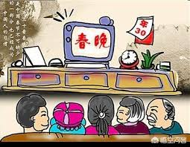

第五课复习 p.142-145
3. The Aspects 了、着、过 (1) S + Verb + (了past 、V1+着progressing+O1+V2+着progressing+O2、过present past) + O 例如: 室友和我看着电视，聊着天。(do two things at the same time) (2) Location + Verb + 着 (stative, current state) + Subject 客厅的墙上 挂 着 一张京剧的照片。

Slide 25
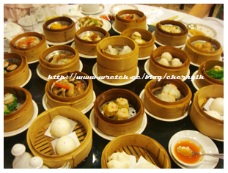

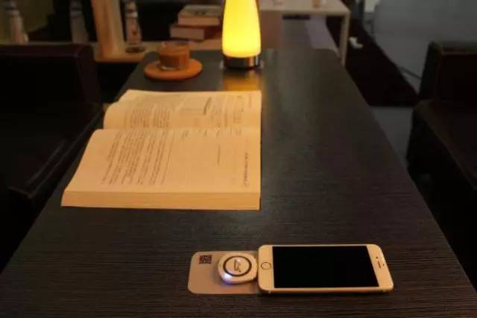
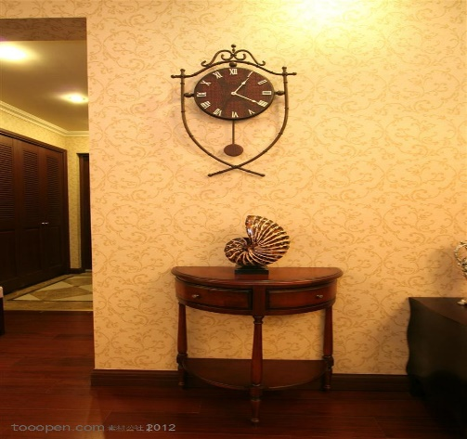


第五课复习 p.142-145
看图说话： (1) S + V1+着progressing+O1+V2+着progressing + O2 （similar to 一边。。，一边。。。。） (2) Location + Verb + 着 (stative, current state) + Subject

Slide 26
第五课复习
Affirmative: S + Verb +了(past tense) or 过(present perfect) + O S +会/要(future tense) /正在(progressive) + Verb + O Negation: S +没有+Verb + O S + 没有 + 过 + O S +不+会/要(future tense) +Verb + O S +不+在 +Verb + O 中文怎么说： 1. Two passengers missed their flight, but I did not miss my flight. 2. My foreign friend has listened to erhu, but he hasn’t heard of Guangong story. 3. Although it’s going to rain tomorrow, it will not rain the day after tomorrow. 4. Although I made myself laughing stock before, I will not in the future. 5. They have never had rice cake before, therefore, they are not used to its flavor. 6. She hasn’t had such big jet leg before, therefore, she can not fall into sleep. 7. We will buy some vitamin for our Chinese friends. It is just that they don’t want us to spend tons of money.

Slide 27
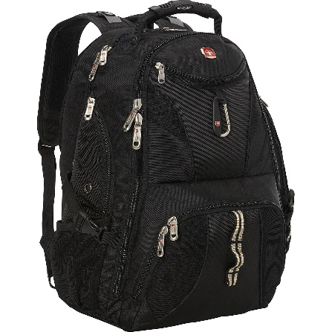
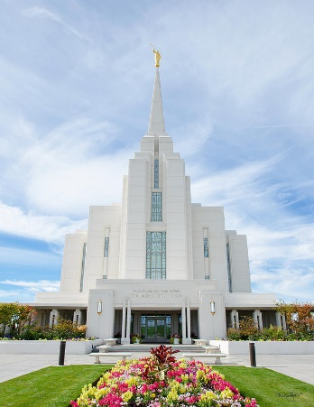
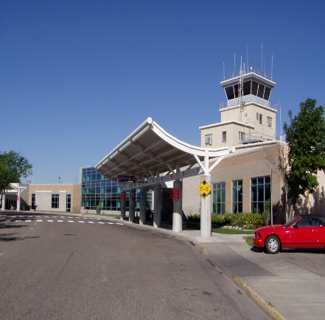
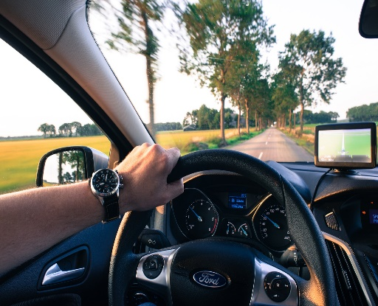
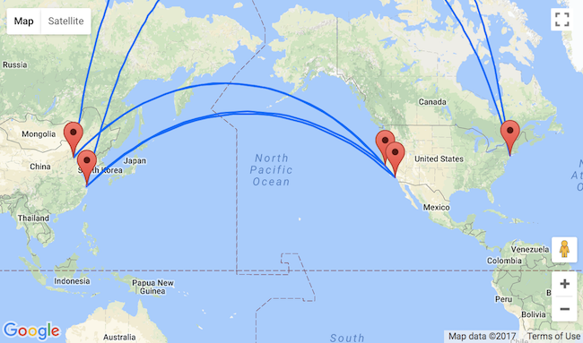
第五课复习 p.142-145
4. S + 有多高/重/远/快/长/大？例如: 一、你的爸妈有多高？我的爸爸一米七八。我的妈妈一米六二。 二、从Smith楼到学生中心有多远？很快。走路五分钟。 看图先问问题，然后回答问题。(Disregard facts if you do not know. One question and answer for each picture)

Slide 28
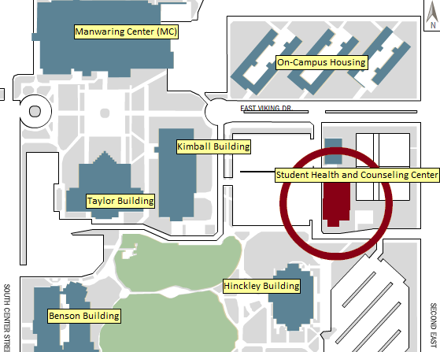
第五课复习p.144
5. Describe directions 例如： 问：从图书馆到书店怎么走？ 答: 你从图书馆出来，往右转，再往前走，书店就到了。
S | 从 Place 出来 | + 往/向 | Directions | Verb
 |  | + 往/向 | 东/西/南/北 | 转/走/跑/开/拐
 |  |  | 前/后
 |  |  | 左/右
 |  |  | Specific Place e.g. 飞机场
说说：从Benson楼出来，到on-campus 公寓怎么走？

Slide 29
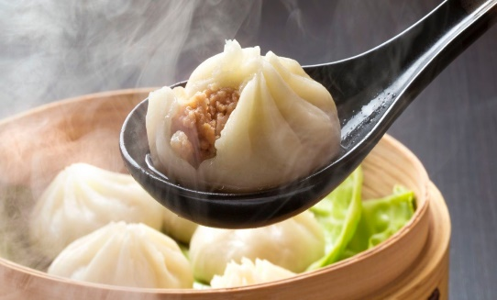
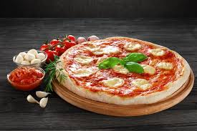
第五课复习 p.142-145
6. Comparison (I) Affirmative Sentences (1) A 像 B A is like B (2) A 跟B一样 A is the same as B (3) A比B + Adj A is more Adj than B (4) A 有B 这么/那么 + Adj A is as Adj. as B Negation Sentences (1) A 不像 B A is not like N (2) A 跟B不一样 A is not the same as B (3) A不比B + Adj A is not Adj. than B (4) A 没有B 这么/那么 + Adj A is not that Adj. as B

Slide 30
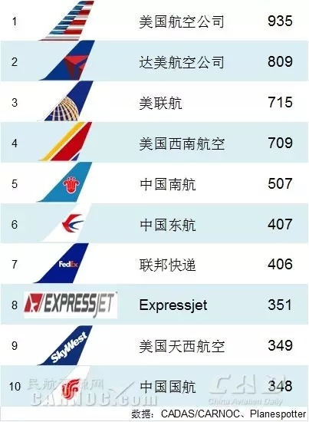
第五课复习 p.142-145
6. Comparison (II) Affirmative Sentences Context, S +比较relatively or Verb …. Context, S + 最most +Adj or Verb …. (3) Context, S + 更more +Adj or Verb …. Negation Sentences (1) Context, S +比较+不+Adj or Verb …. (2) Context, S + 最+不+Adj or Verb …. (3) Context, S + 更+不+Adj or Verb ….

